Slide 1
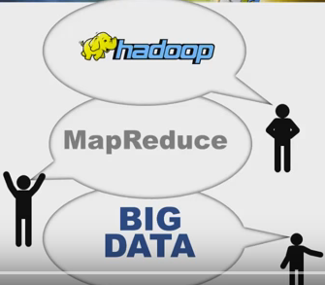
Today’s Topics

Slide 2
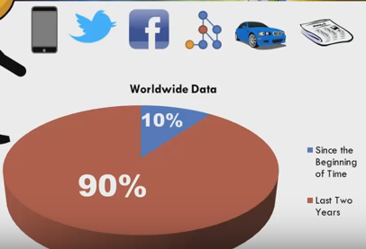

Slide 3
What does Raw Data mean?
Raw data refers to any data object that hasn’t undergone thorough processing, either manually or through automated computer software. Raw data may be gathered from various processes and IT resources.
Raw data is also known as source data, primary data or atomic data.

Slide 4
What do You mean by Data?
In computing, data is information that has been translated into a form that is efficient for movement or processing. Relative to today's computers and transmission media, data is information converted into binary digital form. It is acceptable for data to be used as a singular subject or a plural subject. Raw data is a term used to describe data in its most basic digital format.
Data is distinct pieces of information, usually formatted in a special way. All software is divided into two general categories: data and programs. Programs are collections of instructions for manipulating data.
Data can exist in a variety of forms as numbers or text on pieces of paper, as bits and bytes stored in electronic memory, or as facts stored in a person's mind. Since the mid-1900s, people have used the word data to mean computer information that is transmitted or stored.

Slide 5
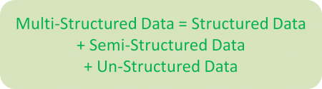
Types of Data
The data in it will be of three types:
Structured data : Structured Data means Data that is in the form of Rows and Columns. So it is very easy to store even in Relational Databases.
Example: Relational data.
Semi Structured data : Semi-Structured Data means Data that is formatted in some way. But it is not formatted in the form of Rows and Columns.
Example: XML data.
Unstructured data : Un-Structured Data means Data that is not formatted in any way. It is not possible to store data in Relational Databases.
Example: Audio files, Videos, Photos, Sensor Data, Web Data, Mobile Data, GPS Data.

Slide 6
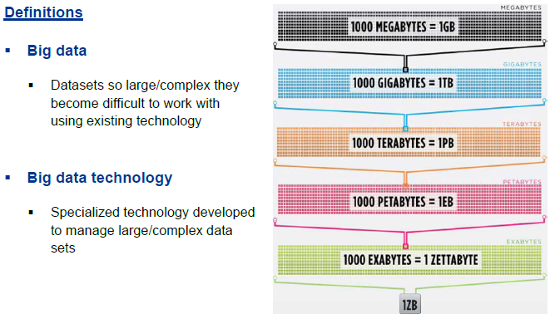
What is Big Data?

Slide 7
What is Big Data?
Big data means really a big data, it is a collection of large datasets that cannot be processed using traditional computing techniques.
Big data is not merely a data, rather it has become a complete subject, which involves various tools, techniques and frameworks.
In Simple Words, Big Data is a technique to solve data problems that are not solvable using Traditional Databases and Tools.
In other way, BigData means not just huge amount of Data. BigData means huge amount of data generating at very fast rate in different formats.
Big Data is a Technique to “Store, Process, Manage, Analysis and Report” a huge amount of variety data, at the required speed, and within the required time to allow Real-time Analysis and Reaction.

Slide 8
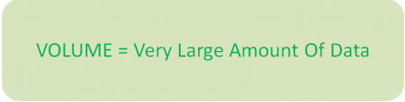
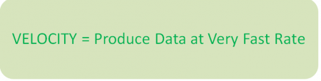
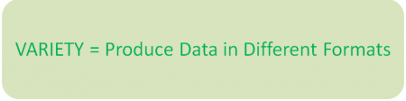
Characteristics of Big Data
Extremely Large Volumes of Data: Very vast amount of Data say TB(Tera Bytes) to PB(Peta Bytes) to Exa Byte(EB) and more
Extremely High Velocity of Data: Velocity means “How fast produce Data”.
Extremely Wide Variety of Data: Variety means “Different forms of Data”.

Slide 9
What Comes Under Big Data?
Big data involves the data produced by different devices and applications. Given below are some of the fields that come under the umbrella of Big Data.
Black Box Data : It is a component of helicopter, airplanes, and jets, etc. It captures voices of the flight crew, recordings of microphones and earphones, and the performance information of the aircraft.
Social Media Data : Social media such as Facebook and Twitter hold information and the views posted by millions of people across the globe.
Stock Exchange Data : The stock exchange data holds information about the ‘buy’ and ‘sell’ decisions made on a share of different companies made by the customers.
Power Grid Data : The power grid data holds information consumed by a particular node with respect to a base station.
Transport Data : Transport data includes model, capacity, distance and availability of a vehicle.
Search Engine Data : Search engines retrieve lots of data from different databases.

Slide 10
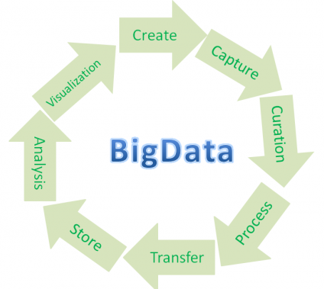
Big Data life cycle management

Slide 11
Big Data Technologies
To harness the power of big data, we would require an infrastructure that can manage and process huge volumes of structured and unstructured data in real time and can protect data privacy and security.
There are various technologies in the market from different vendors including Amazon, IBM, Microsoft, etc., to handle big data. While looking into the technologies that handle big data, we examine the following two classes of technology:

Slide 12
Big Data Technologies
Operational Big Data
This include systems like MongoDB that provide operational capabilities for real-time, interactive workloads where data is primarily captured and stored.
Analytical Big Data
This includes systems like Massively Parallel Processing (MPP) database systems and MapReduce that provide analytical capabilities for retrospective and complex analysis that may touch most or all of the data.

Slide 13
Big Data Technologies
Different Big Data and Cloud Platforms Solutions available in the current market:
Amazon Web Services (AWS),
Google Cloud Platform,
Microsoft Azure,
IBM Bluemix,
Pivotal Cloud Foundry,
Yahoo Cloud Platform etc.

Slide 14
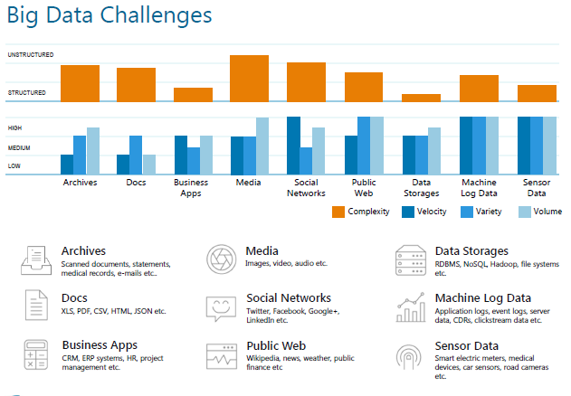
Big Data Challenges

Slide 15
Big Data Challenges
Big Data Challenges
The major challenges associated with big data are as follows:
Capturing data
Curation
Storage
Searching
Sharing
Transfer
Analysis
Presentation

Slide 16
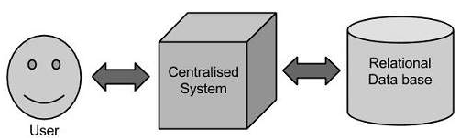
Traditional Approach
In this approach, an enterprise will have a computer to store and process big data. Here data will be stored in an RDBMS like Oracle Database, MS SQL Server or DB2 and sophisticated software can be written to interact with the database, process the required data and present it to the users for analysis purpose.

Slide 17
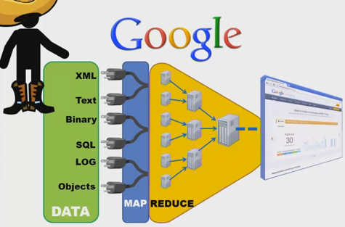
MapReduce Algorithm
Google’s Solution:
Google solved this problem using an algorithm called MapReduce.

Slide 18
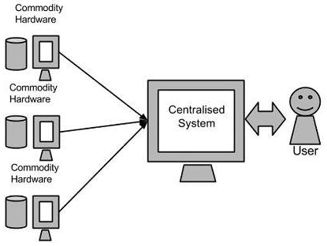
MapReduce Algorithm
Google’s Solution
This algorithm divides the task into small parts and assigns those parts to many computers connected over the network, and collects the results to form the final result dataset.
Above diagram shows various commodity hardwares which could be single CPU machines or servers with higher capacity.

Slide 19
MapReduce
MapReduce
While processing large set of data, we should definitely address scalability and efficiency in the application code that is processing the large amount of data.
Map reduce algorithm (or flow) is highly effective in handling big data.

Slide 20
Illustration of MapReduce
Hadoop MapReduce is a software framework for easily writing applications which process big amounts of data in-parallel on large clusters (thousands of nodes) of commodity hardware in a reliable, fault-tolerant manner.
The term MapReduce actually refers to the following two different tasks that Hadoop programs perform:
The Map Task: This is the first task, which takes input data and converts it into a set of data, where individual elements are broken down into tuples (key/value pairs).
The Reduce Task: This task takes the output from a map task as input and combines those data tuples into a smaller set of tuples. The reduce task is always performed after the map task.

Slide 21
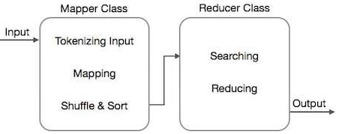
Illustration of MapReduce
The MapReduce algorithm contains two important tasks, namely Map and Reduce.
1)The map task is done by means of Mapper Class.
2) The reduce task is done by means of Reducer Class.
Mapper class takes the input, tokenizes it, maps and sorts it. The output of Mapper class is used as input by Reducer class, which in turn searches matching pairs and reduces them.

Slide 22
MapReduce Algorithm Steps
MapReduce Algorithm uses the following three main steps:
1) Map Function
2) Shuffle Function
3) Reduce Function

Slide 23
Example of MapReduce Problem Statement: Count the number of occurrences of each word available in a DataSet.

Slide 24
Mapping
Shuffling
Splitting
Reducing
Deer, 1
Bear, 1
River, 1
Bear, 1
Bear, 1
Bear, 2
Input
Deer Bear River
Final Result
Car, 1
Car, 1
Car, 1
Car, 3
Deer Bear River
Car Car River
Deer Car Bear
Bear, 2
Car, 3
Deer, 2
River, 2
Car, 1
Car, 1
River, 1
Car Car River
Deer, 1
Deer, 1
Deer, 2
Deer, 1
Car, 1
Bear, 1
Deer Car Bear
River, 1
River, 1
River, 2

Slide 25
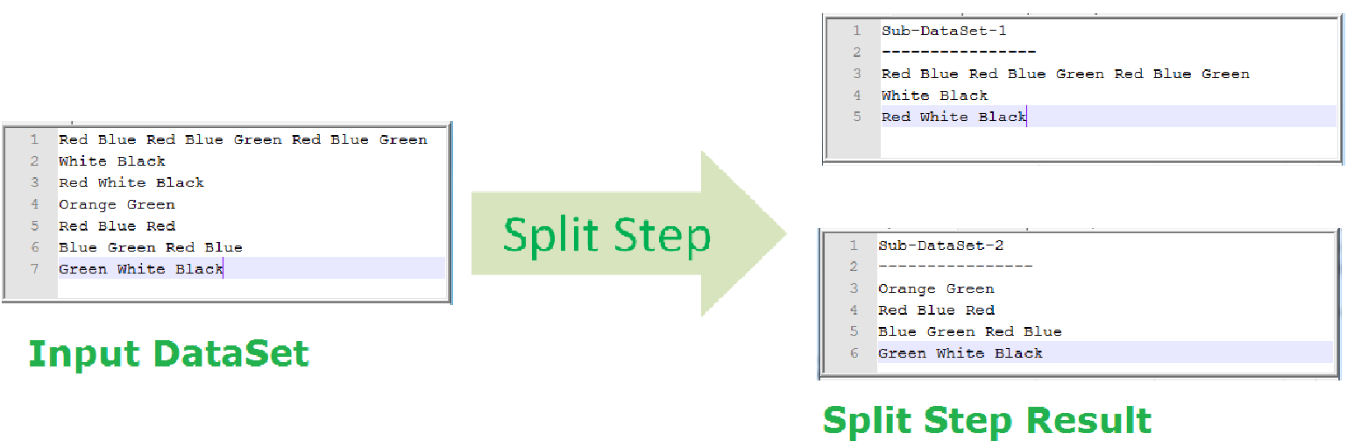
Example of MapReduce Problem Statement: Count the number of occurrences of each word available in a DataSet.
MapReduce – Map Function (Split Step)

Slide 26
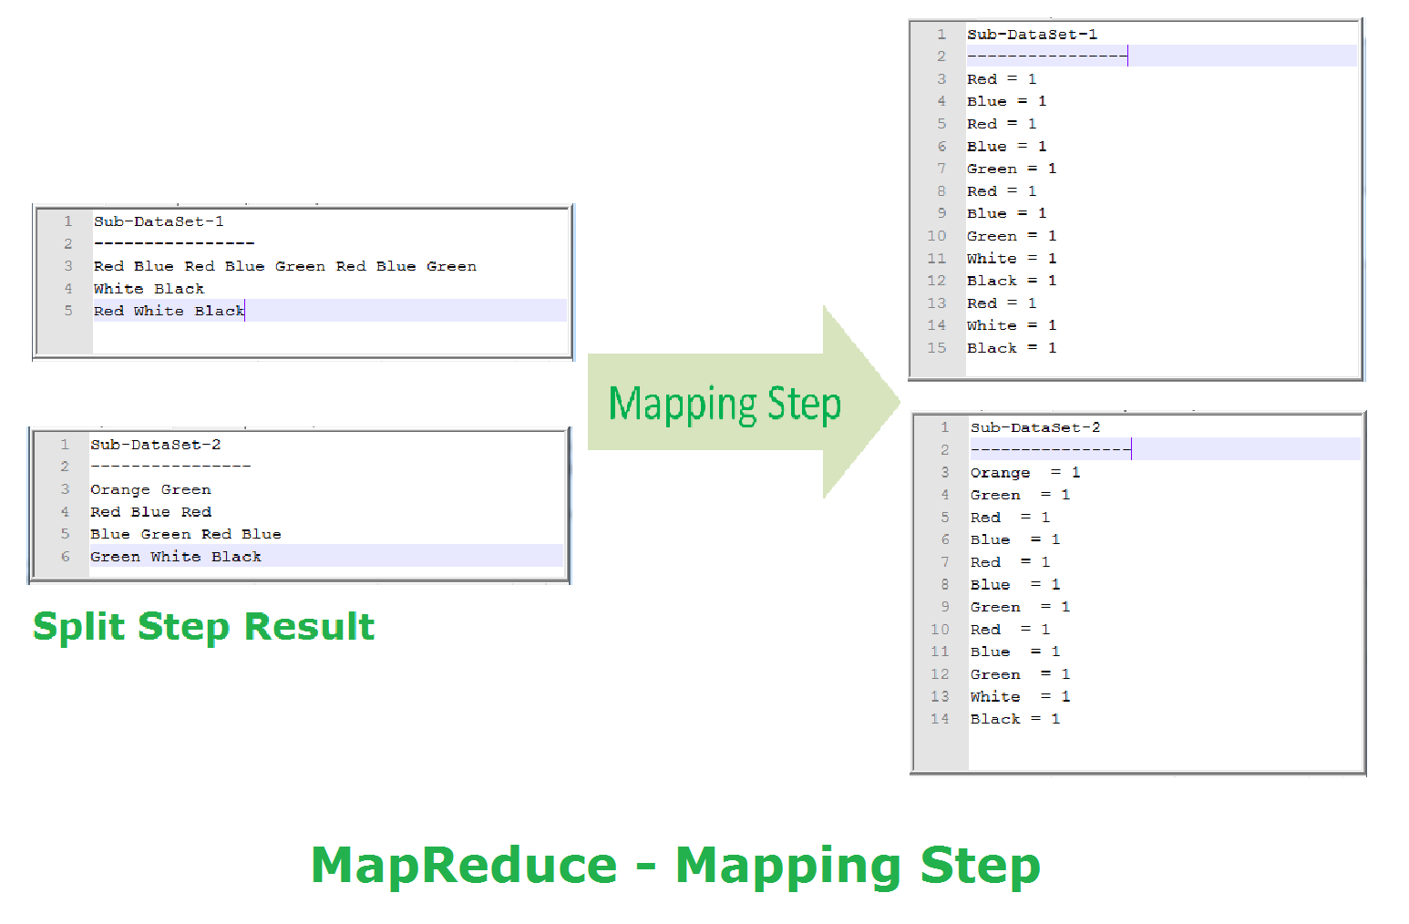
MapReduce – Map Function (Mapping Step)

Slide 27
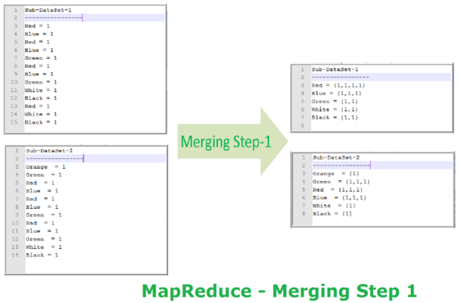
MapReduce – Shuffle Function (Merge Step)

Slide 28
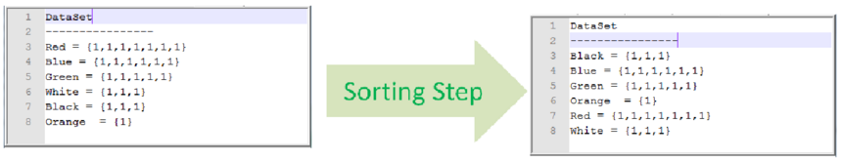
MapReduce – Shuffle Function (Sorting Step)

Slide 29
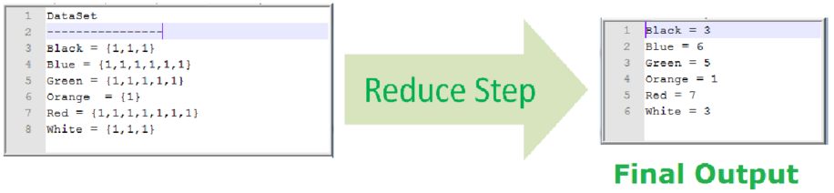
MapReduce – Reduce Function (Reduce Step)

Slide 30
Hadoop- Big Data Solutions
Map reduce algorithm was used to develop an open-source framework called Hadoop is that allows to store and process big data in a distributed environment across clusters of computers using simple programming models.
It is designed to scale up from single servers to thousands of machines, each offering local computation and storage.
Hadoop is an Open Source framework from Apache Software Foundation to solve BigData Problems. It is completely written in Java Programming Language.

Slide 31
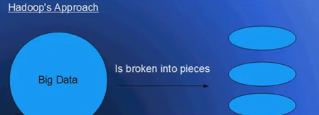
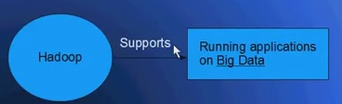
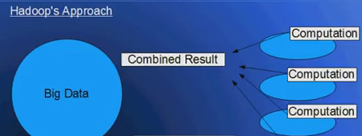
Hadoop- Big Data Solutions
Hadoop is an open-source software framework for storing data and running applications on clusters of commodity hardware. It provides massive storage for any kind of data, enormous processing power and the ability to handle virtually limitless concurrent tasks or jobs.

Slide 32
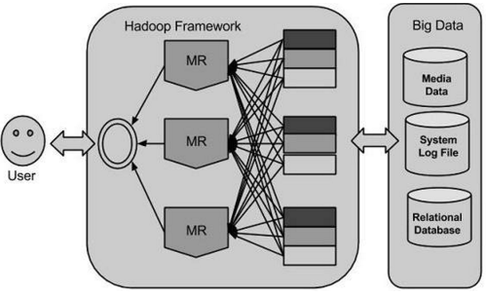
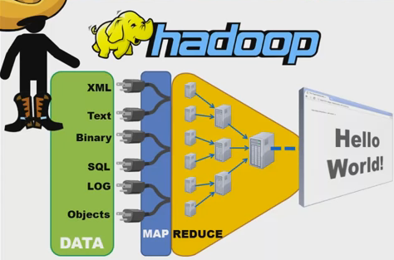
Hadoop- Big Data Solutions

Slide 33
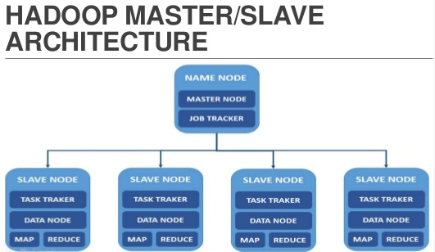
Hadoop Architecture
HDFS comprises of 2 important components-NameNode, and DataNode. HDFS operates on a Master-Slave architecture model where the NameNode acts as the master node for keeping a track of the storage cluster and the DataNode acts as a slave node summing up to the various systems within a Hadoop cluster.

Slide 34

Thank You…….
Any Questions???

